Slide 1


Design & Develop Front End Community Portal
Module Project
Module: NICF-UI Frameworks
Course: NICF-Advanced Certificate in Web Development
2022/07/14
Learner Name Enrollment ID
:
:
Start Date :
End Date : Submission Date :
Chathushi Jayarathna
2022/07/16
22/08/2022
Presentation Date :

Slide 2
Document History
Version Number | Effective Date of release | Summary of Included Changes | Author
1 | 4th March 2016 | First Edition | Satya CVS
2 | 7th April 2017 | Changed for Module 2 | Shrinivas K R
3 | 14th May 2017 | Changed for Module 3 | Shrinivas K R
4 | 03rd May 2018 | Changed for RQF | Shrinivas K R
5 | 16th Sep 2018 | Change for Java Track | Shrinivas K R

Slide 3
Contents
S. No. | Description
01 | Development Tools
02 | Feedback Techniques
03 | Pages Inventory
04 | Forms & Pages Design
05 | Forms & Pages Feedback
06 | HTML Pages
07 | Usability Metrics
08 | User Interaction Steps
09 | User Interaction Flowchart
10 | Current & Desired Usability
11 | Prototype Screen
12 | Prototype Feedback
13 | Usability Test
14 | Project Milestones & Tasks
15 | Milestone Feedback & Action taken
16 | Project Results
17 | Proposed Improvements

Slide 4

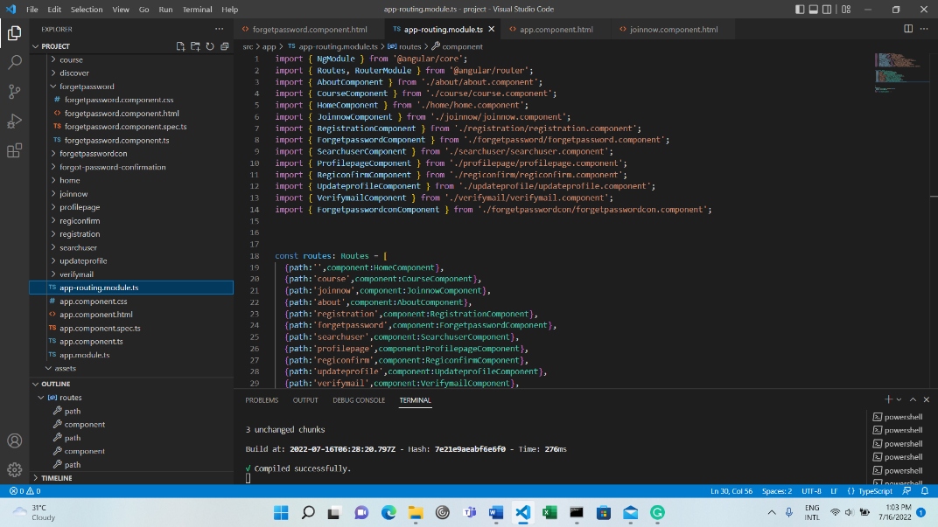
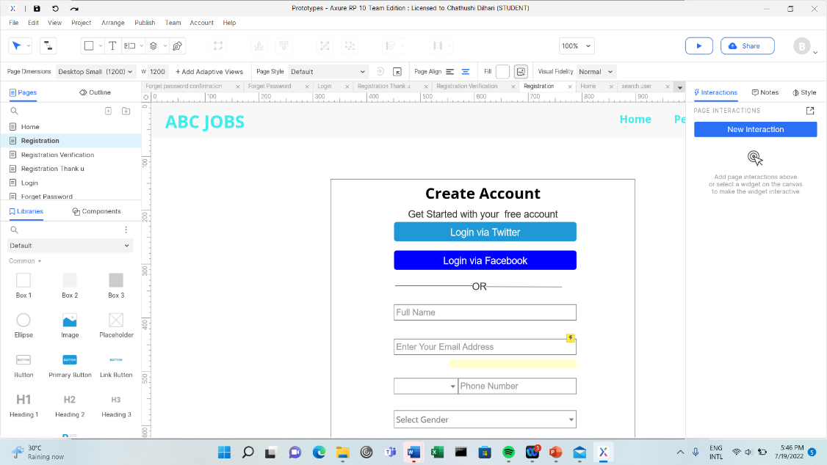

1. Development Tools
Visual Studio Code
Axure

Slide 5

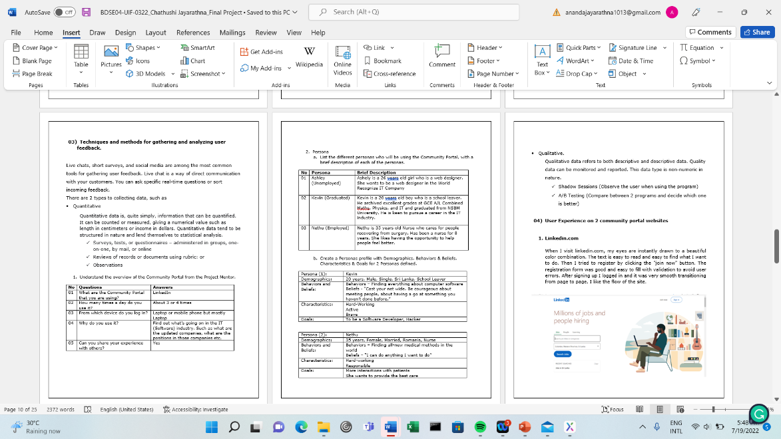
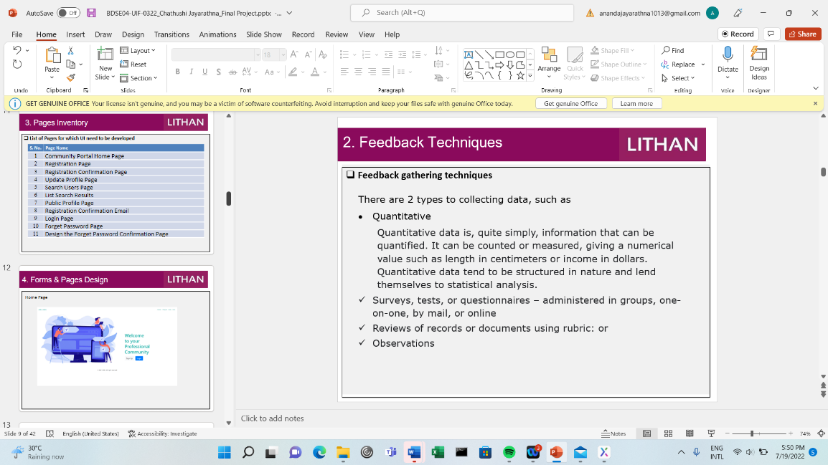

1. Development Tools
MS Word
MS PowerPoint

Slide 6

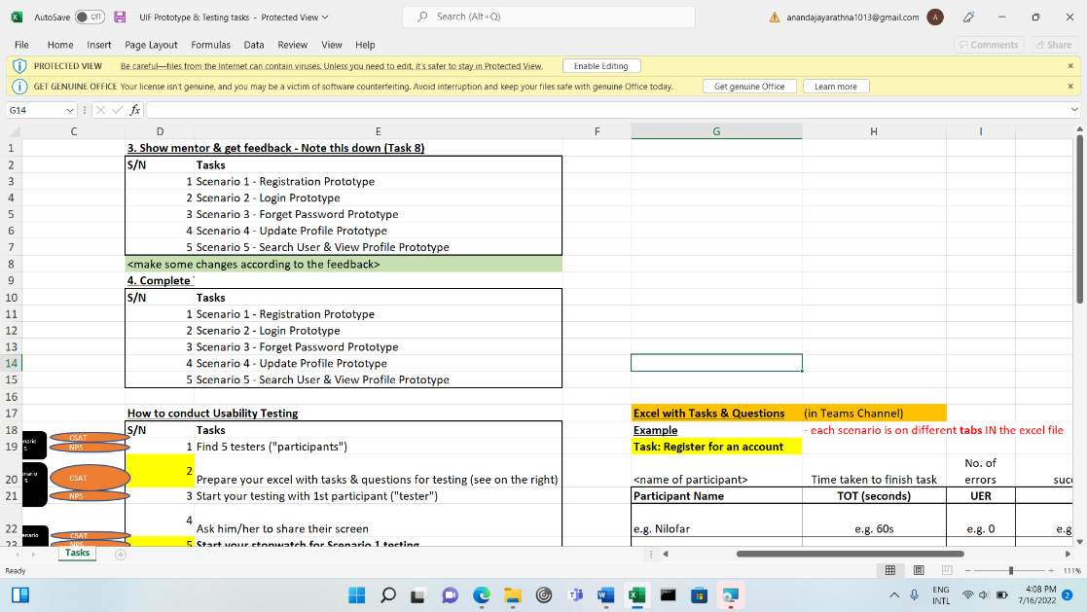
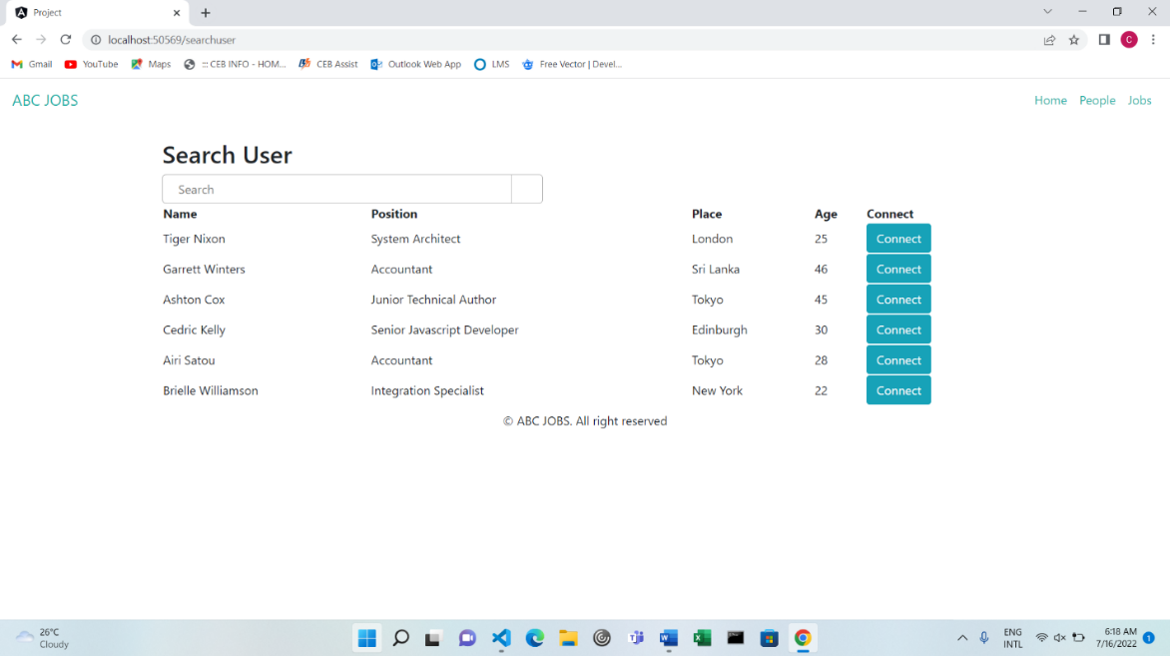

1. Development Tools
MS Excel
Chrome

Slide 7

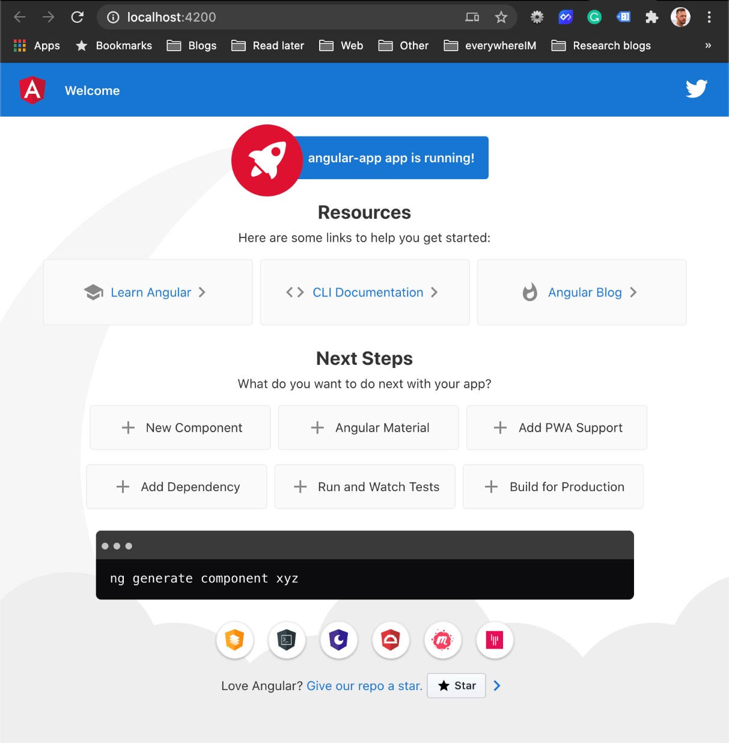
1. Development Tools
Angular

Slide 8

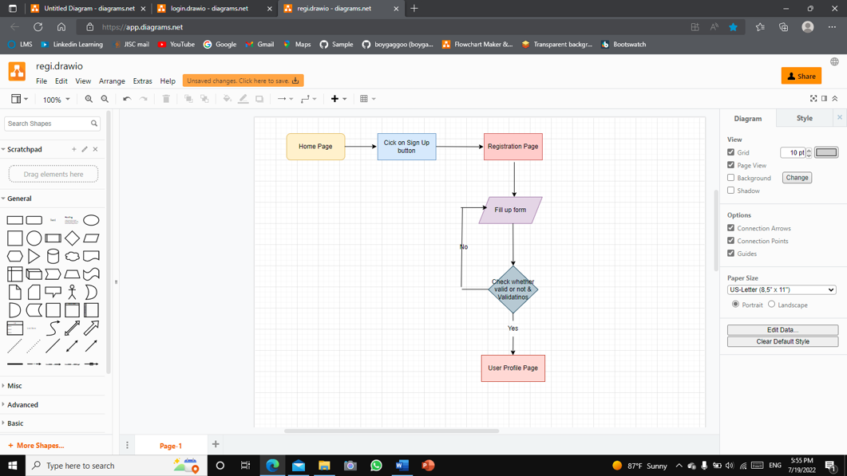
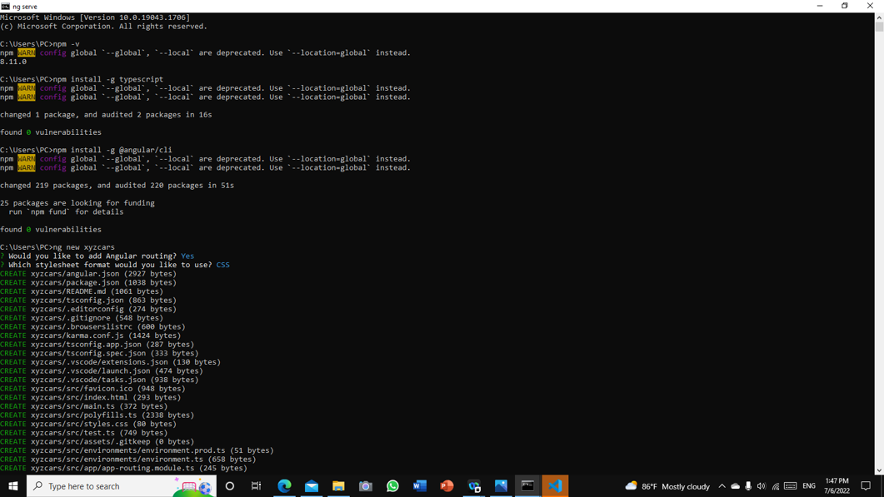

1. Development Tools
Regi.drawio
cmd

Slide 9


2. Feedback Techniques
Feedback gathering techniques
There are 2 types to collecting data, such as
Quantitative
Quantitative data is, quite simply, information that can be quantified. It can be counted or measured, giving a numerical value such as length in centimeters or income in dollars. Quantitative data tend to be structured in nature and lend themselves to statistical analysis.
Surveys, tests, or questionnaires – administered in groups, one-on-one, by mail, or online
Reviews of records or documents using rubric: or
Observations

Slide 10
2. Feedback Techniques
Qualitative.
Qualitative data refers to both descriptive and descriptive data. Quality data can be monitored and reported. This data type is non-numeric in nature.
Shadow Sessions (Observe the user when using the program)
A/B Testing (Compare between 2 programs and decide which one is better)

Slide 11

3. Pages Inventory
List of Pages for which UI need to be developed
S. No. | Page Name
1 | Community Portal Home Page
2 | Registration Page
3 | Registration Confirmation Page
4 | Update Profile Page
5 | Search Users Page
6 | List Search Results
7 | Public Profile Page
8 | Registration Confirmation Email
9 | Login Page
10 | Forget Password Page
11 | Design the Forget Password Confirmation Page

Slide 12
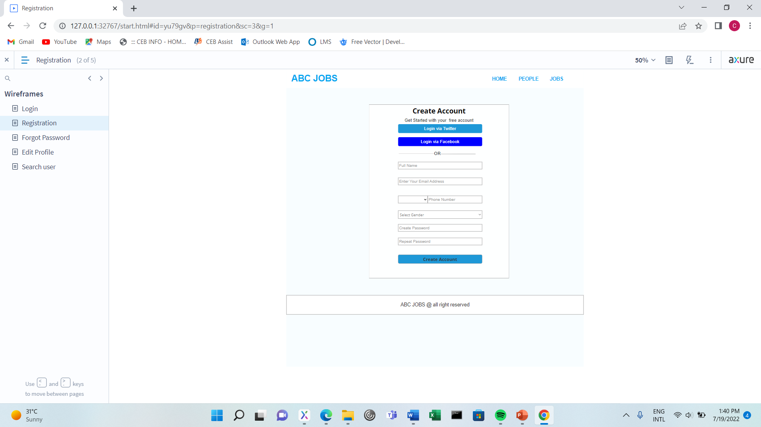
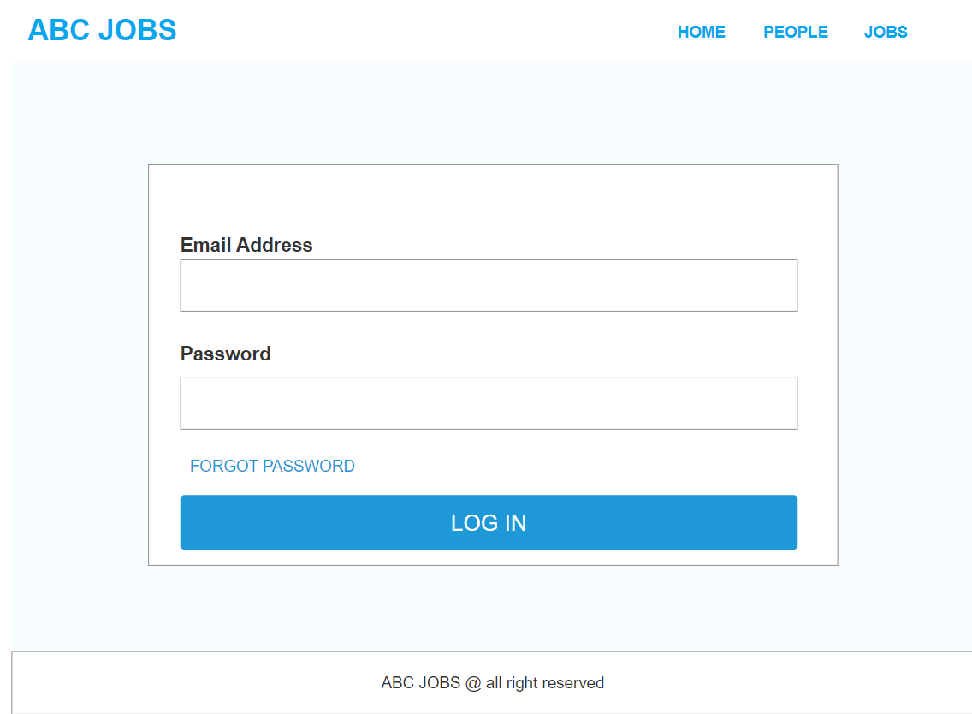
4. Forms & Pages Design
Login Page
Registration Page

Slide 13
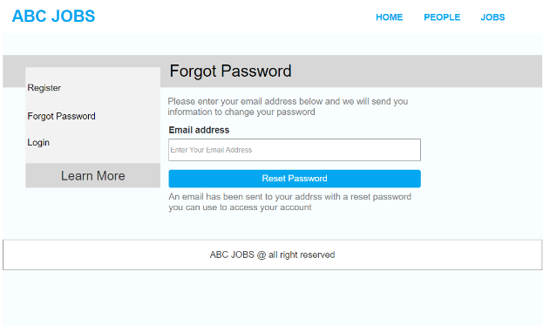
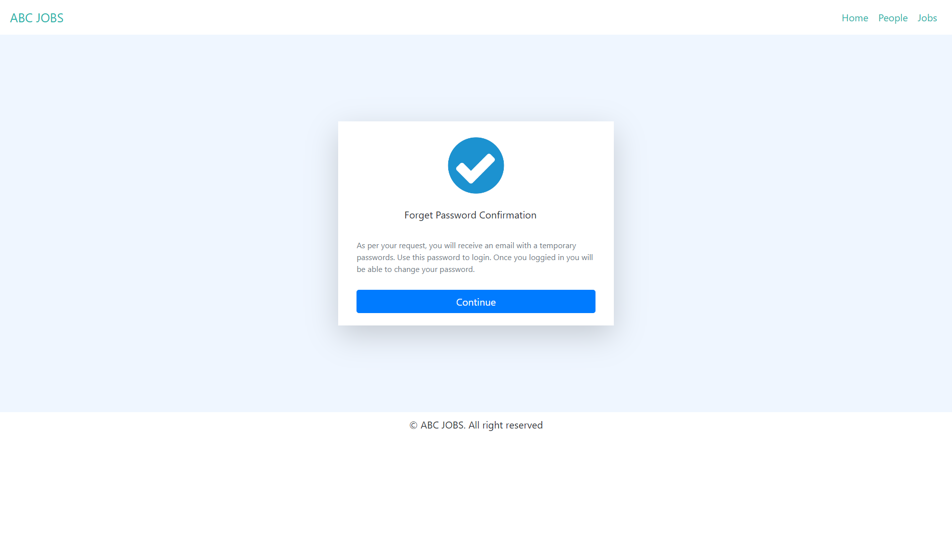
4. Forms & Pages Design
Forgot password page
Forgot password confirmation page

Slide 14
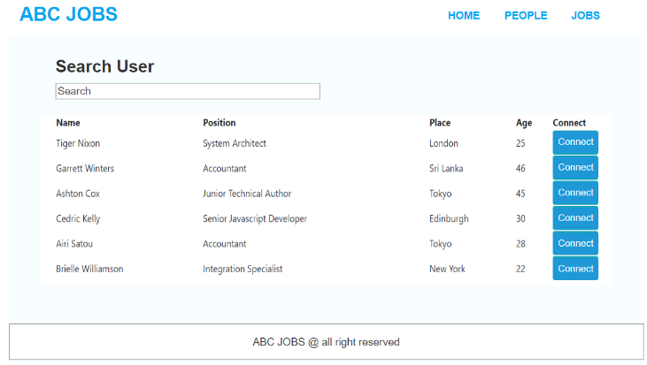
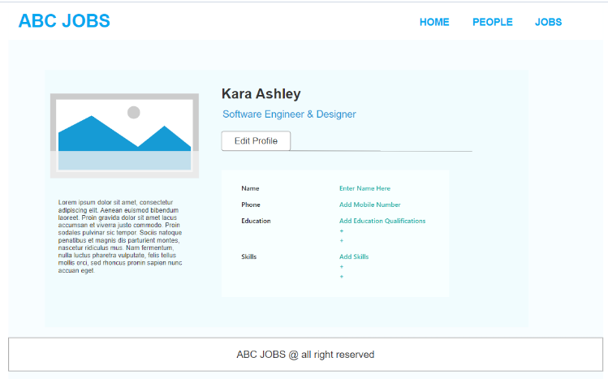
4. Forms & Pages Design
Search user page
Update Profile Page

Slide 15
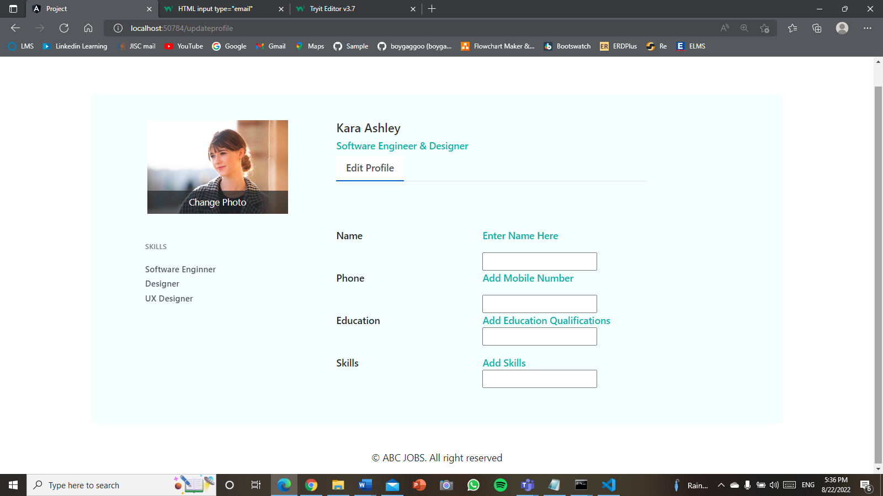

5. Forms & Pages Feedback
c | Forms / Pages | Feedback Received | Modifications Implemented
01 | Update Profile Page | It would be great if you could upload a cover photo | Add cover photo section
After
Before

Slide 16

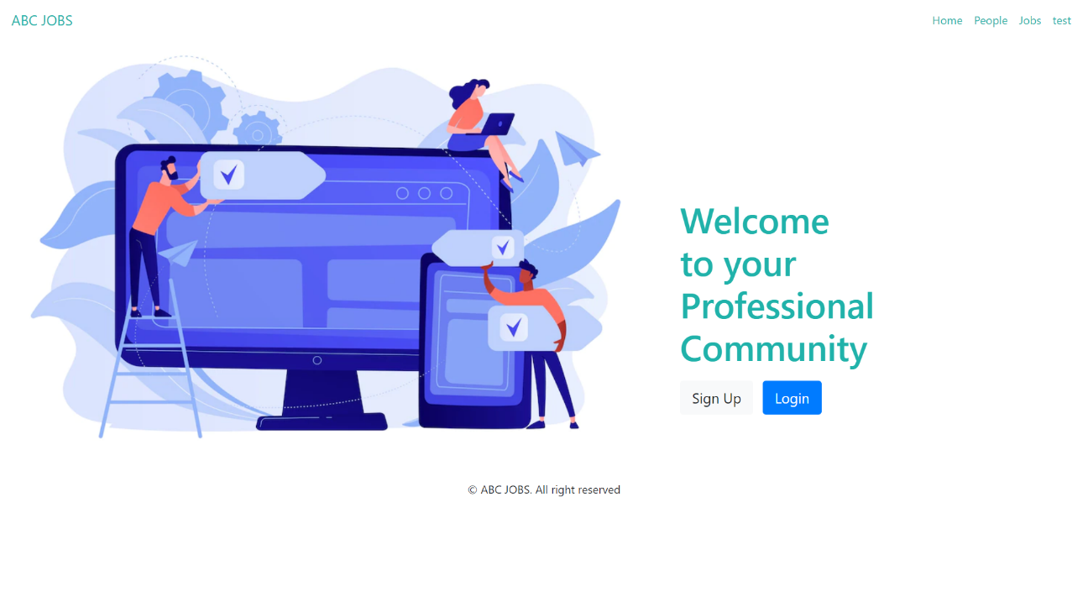
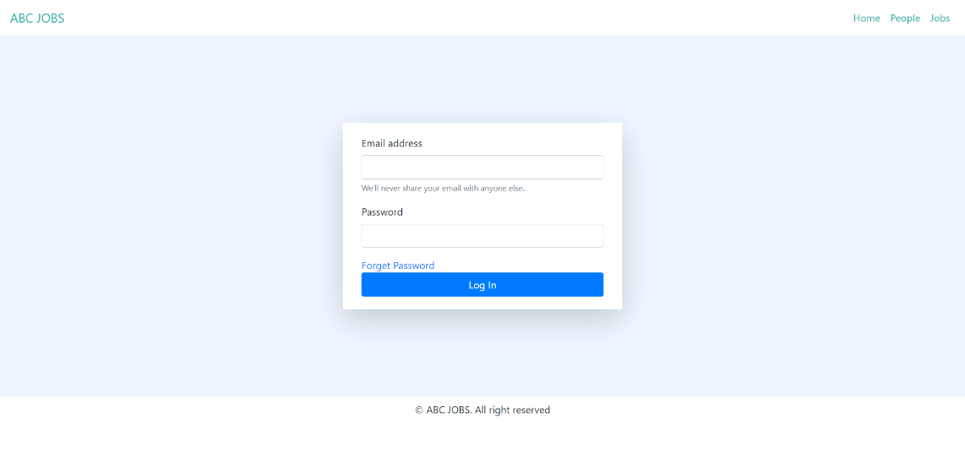
6. HTML Pages
Home Page
Login Page

Slide 17
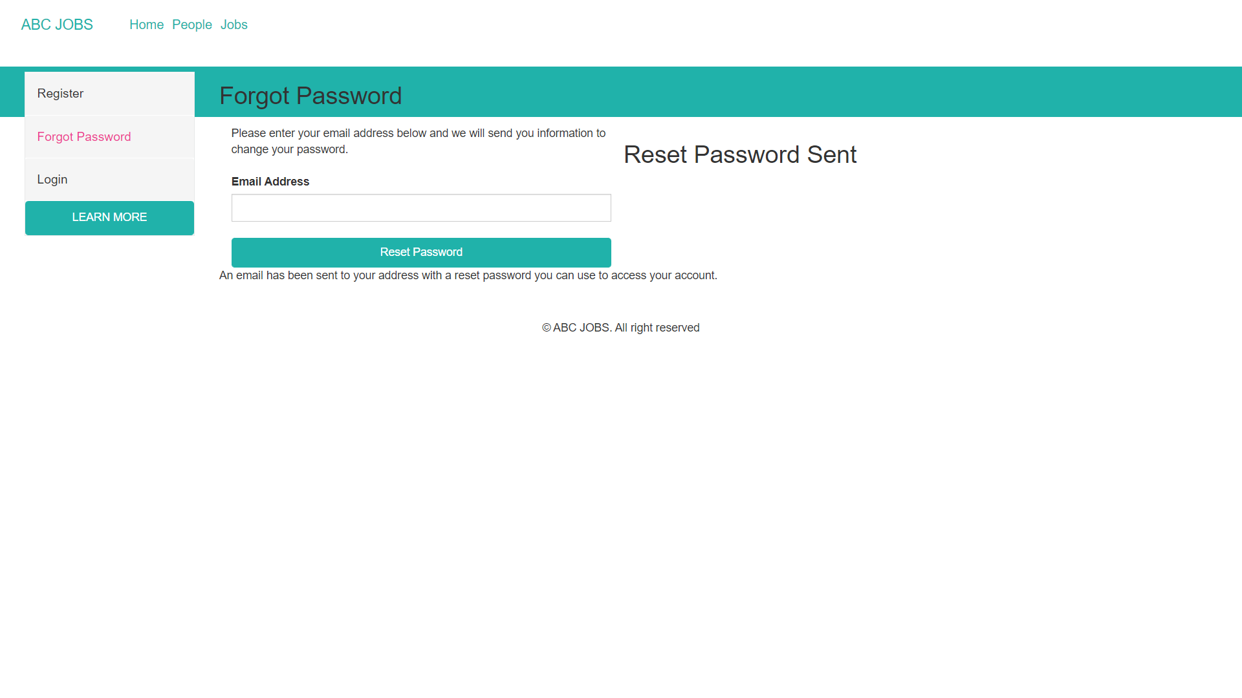
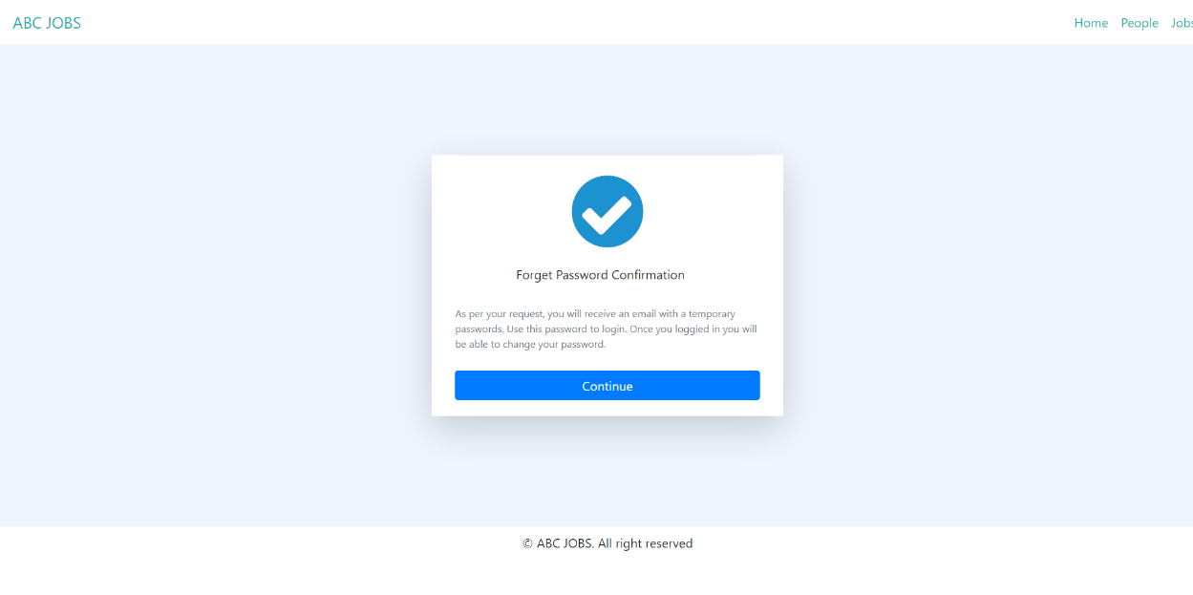
6. HTML Pages
Forgot Password Page
Forgot Password Conformation

Slide 18
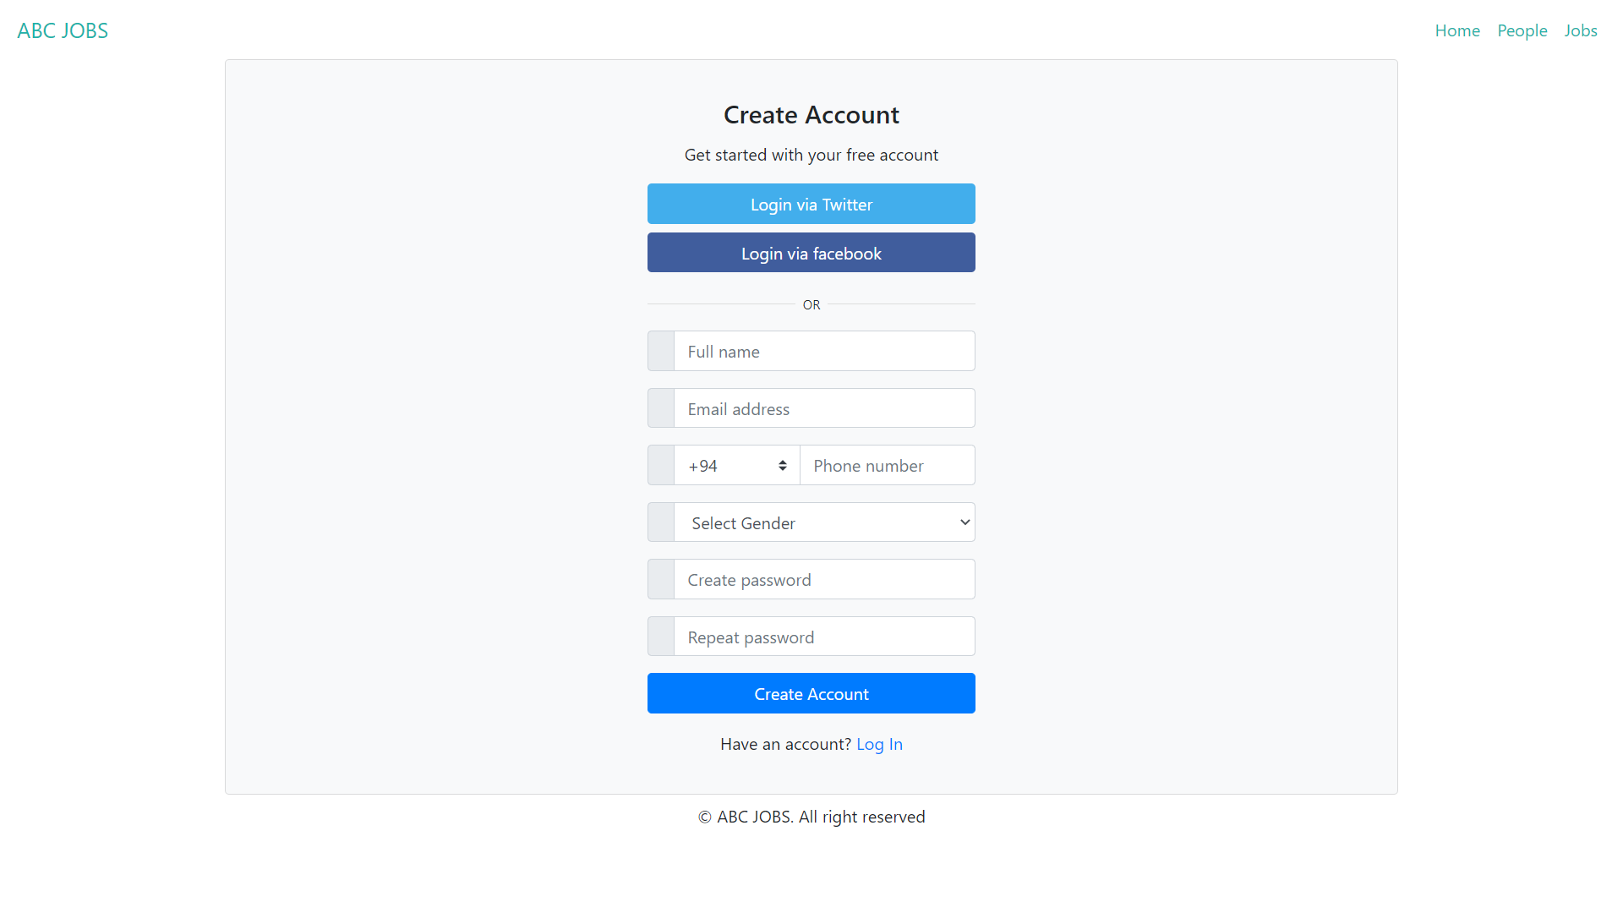
6. HTML Pages
Registration Form

Slide 19
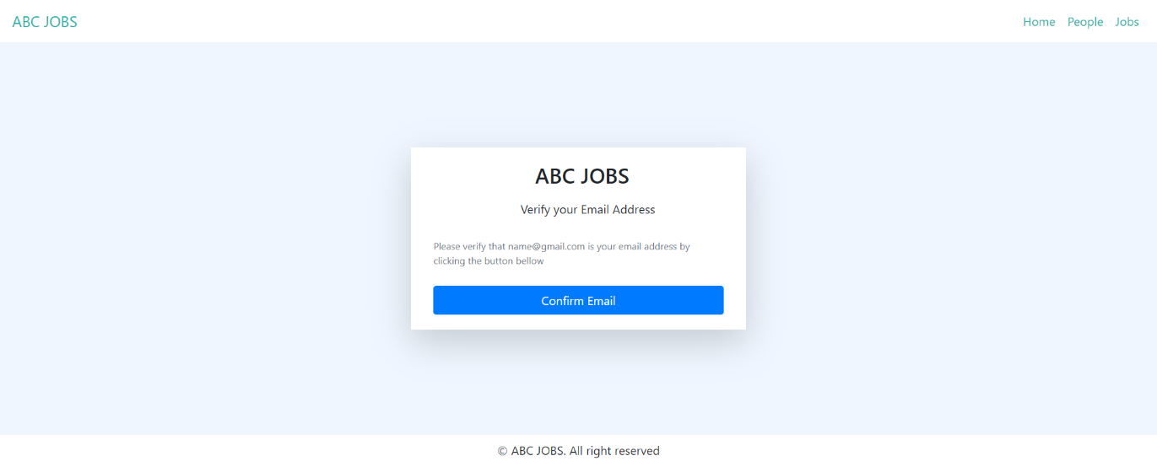
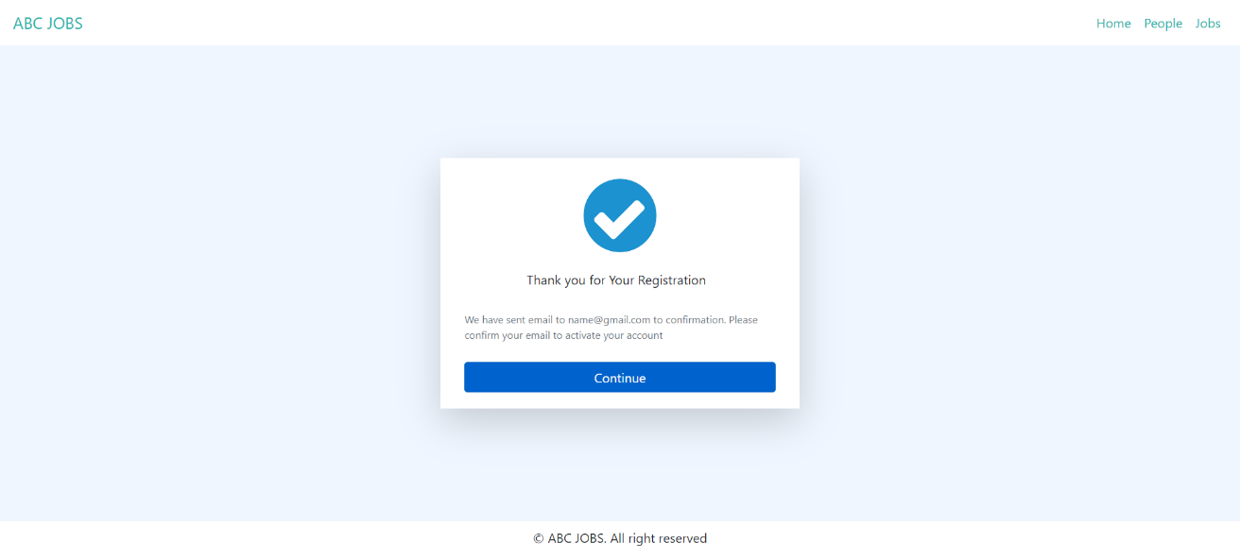
6. HTML Pages
Registration Confirmation Email
Registration Thank you

Slide 20
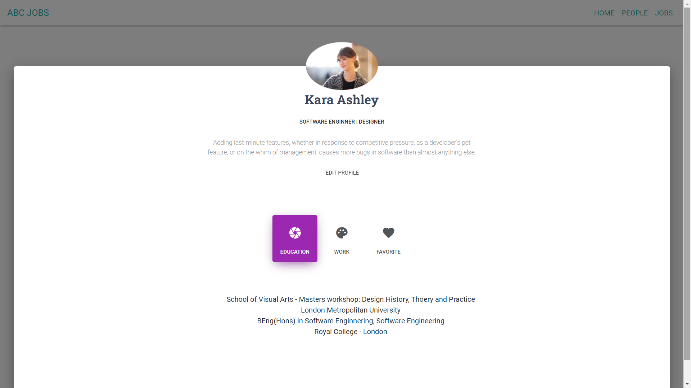
6. HTML Pages
User Profile page

Slide 21
6. HTML Pages
Update Profile page

Slide 22
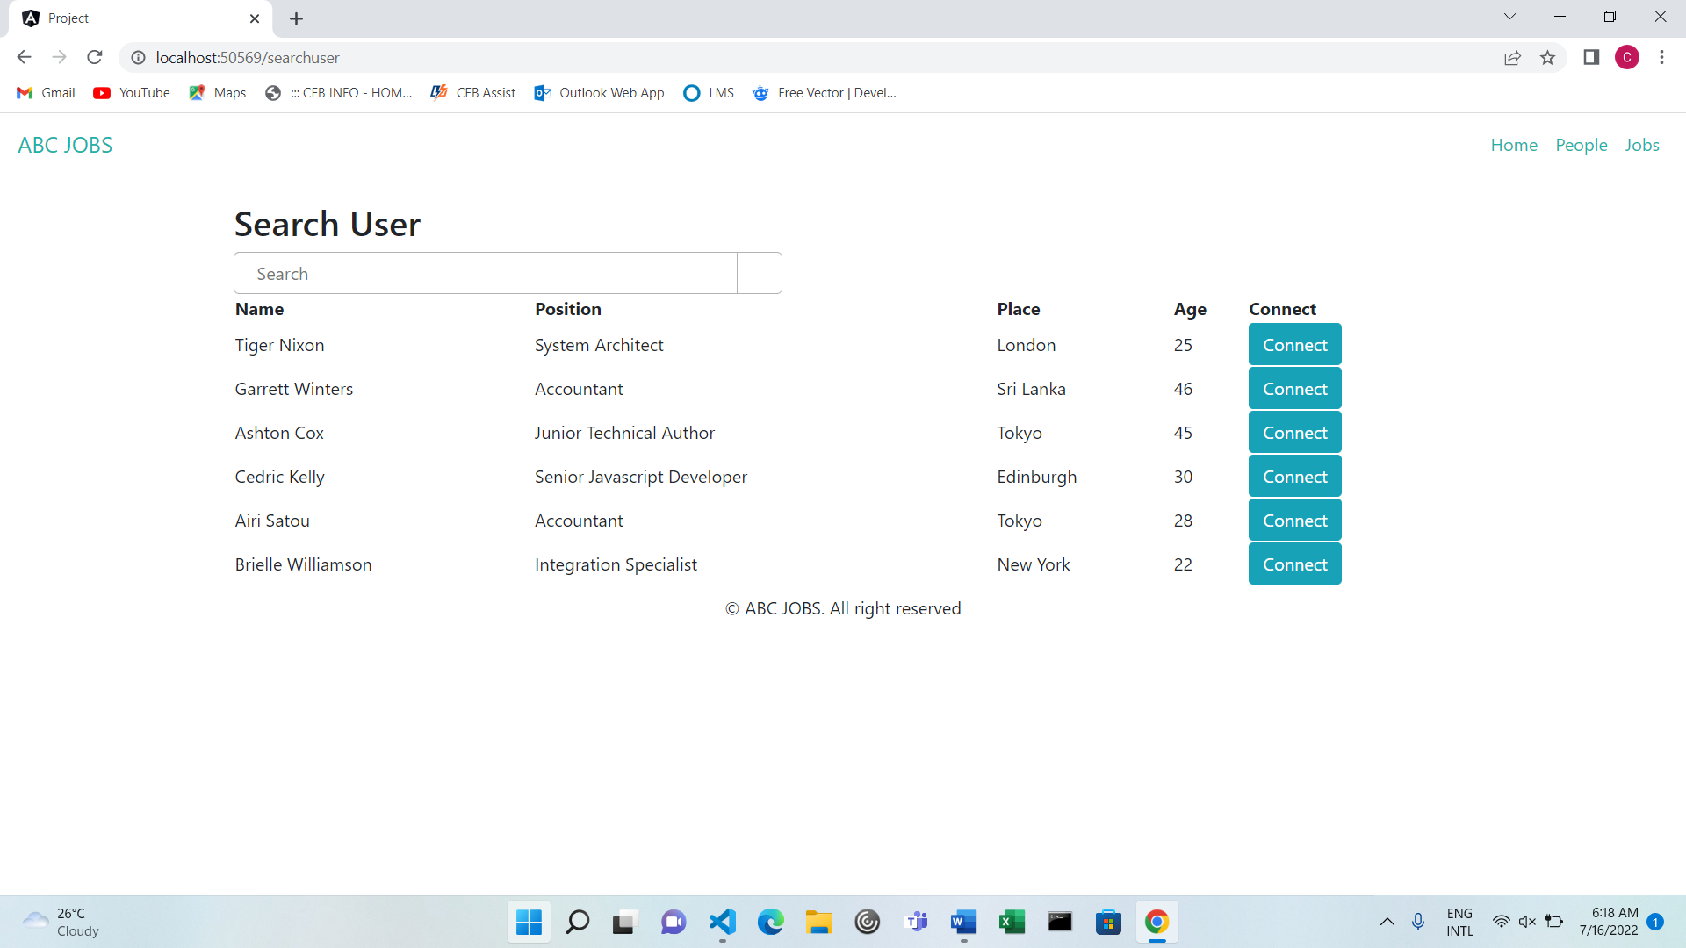
6. HTML Pages
Search user Page

Slide 23
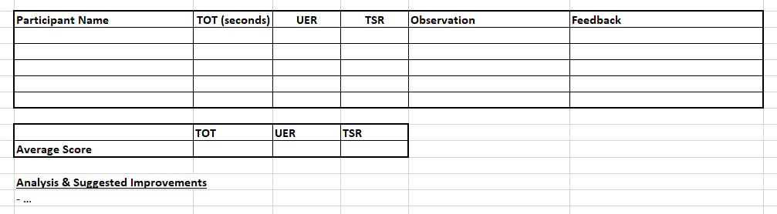
7. Usability Metrics
7. Usability Metrics
Test name (The content name which is going to be tested)
Test cases (For the serial and case number of test for the selected form)
Features (The section with which developer want to test)
Description (Description section is for the description of the selected page)
Steps to execute (Explain the steps need to execute on the text)
Test data (initially not required)
Expected results ( the result will be displayed after execute the mentioned test)

Slide 24
8. User Interaction Steps
Scenario 1: Login Page
Interaction Process
From Portal Home Page User clicks on “Login” button link and reaches the Login page User is required to key in all the required information (Email address and password) Upon clicking on the login button validation checks will be performed and error messages will be promoted If cannot remember password user can click “Forgot password” link and reaches the forgot password page to reset password User is required to add email address Upon clicking on reset password button user can reset password If their no invalid details user will enters to the community portal successfully

Slide 25
8. User Interaction Steps
Scenario 1: Registration Page
Interaction Process
From landing home page Users click on the “sign up” button to reach the login page. User is required to key in the required information(Name, Email, Phone number, Gender, password) and clicks on the “sign up” button Upon clicking on the signup button, validation checks will be performed, and error messages will be prompted to the user if any required information is missing. Displaying the Registration confirmation page Upon clicking on the “Continue” button reach the registration confirmation mail page Upon clicking the “Verify Email address” button reach the Login page User clicking the “sign in” link reaches the login page

Slide 26
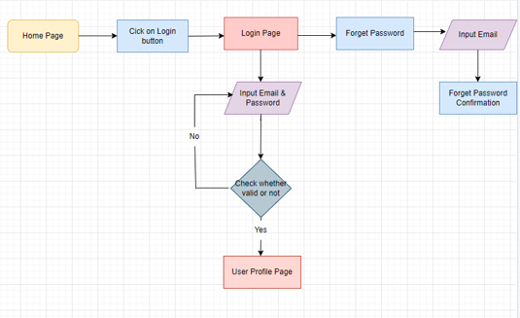
9. User Interaction Flowchart
Scenario 1: Login Page

Slide 27
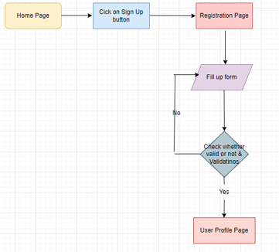
9. User Interaction Flowchart
Scenario 1: Registration Page

Slide 28
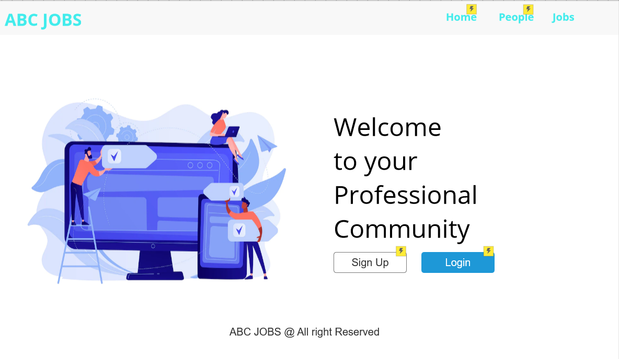
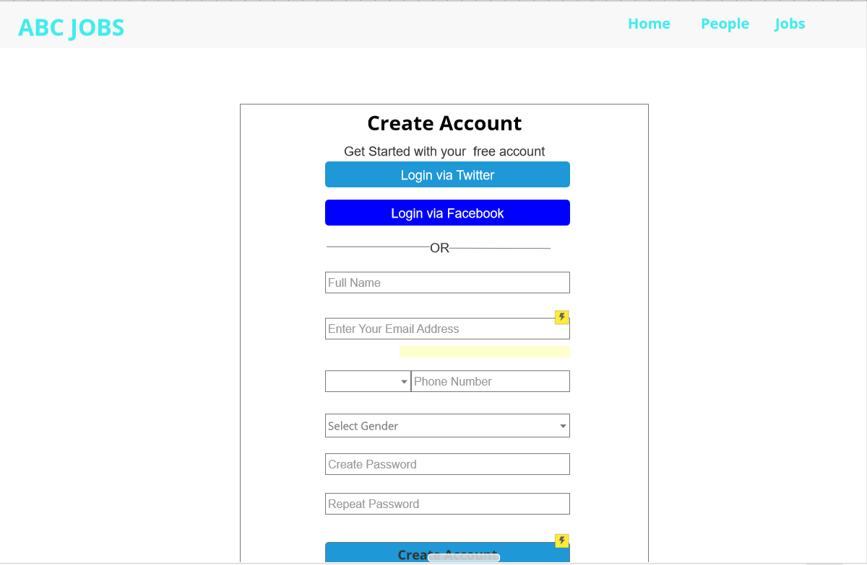
11. Prototype Screen
Home Page
Registration page

Slide 29
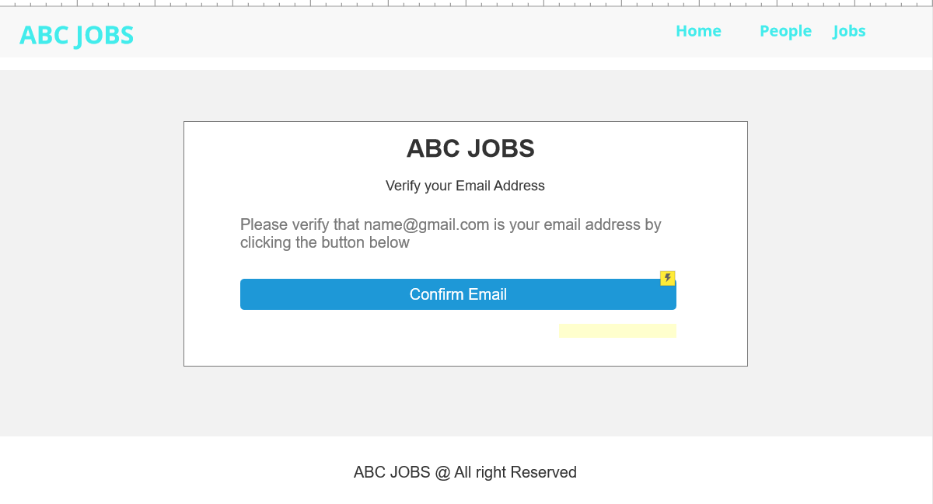
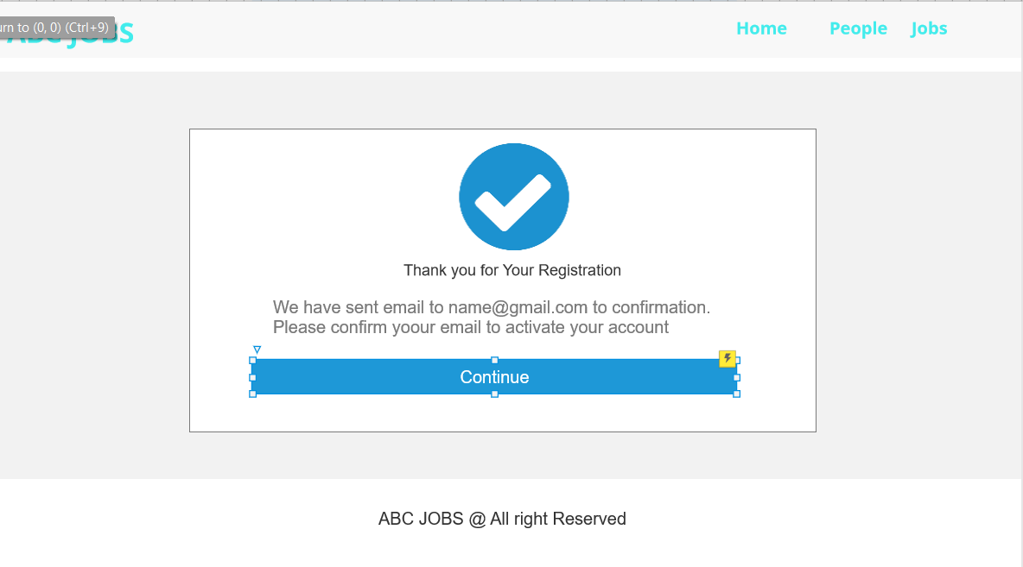
11. Prototype Screen
Email Verification
Registration Thank you

Slide 30
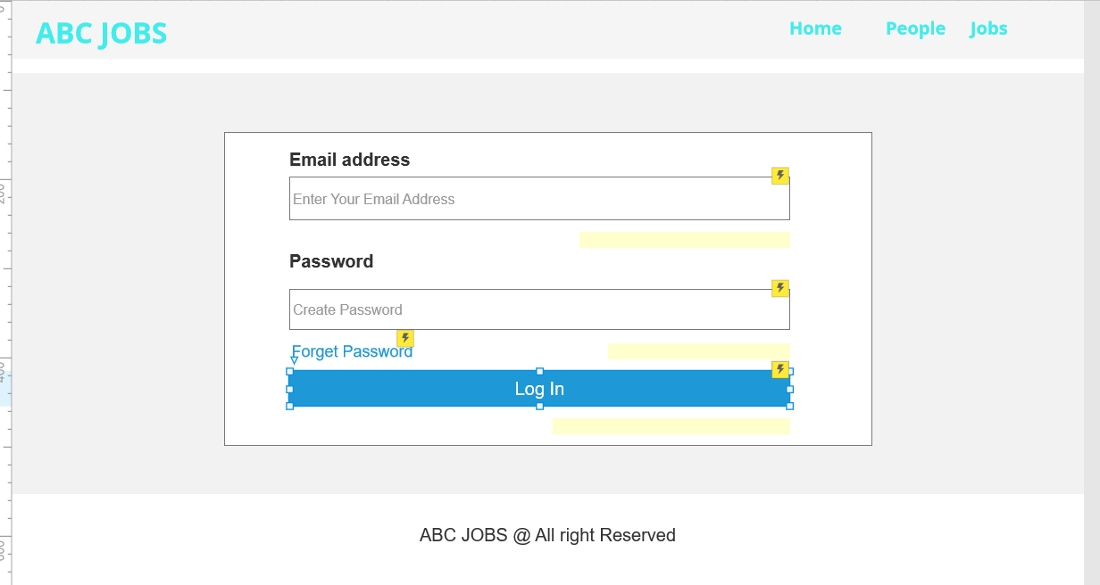
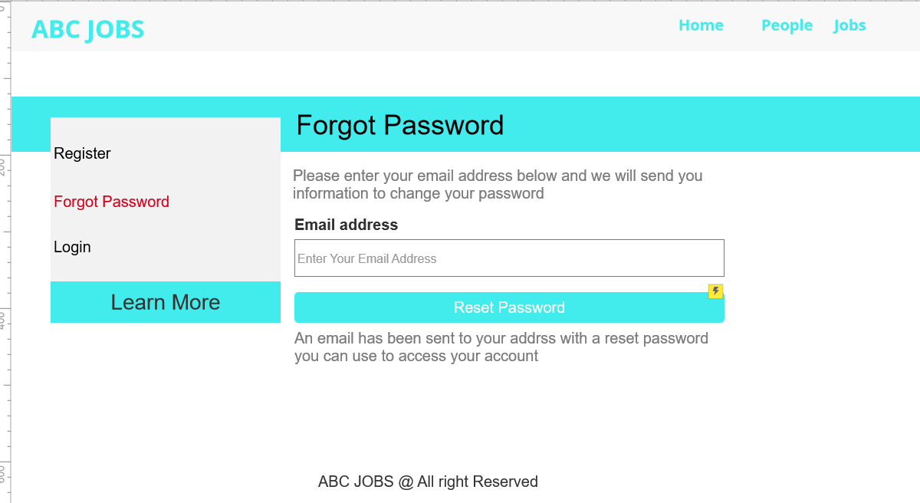
11. Prototype Screen
Login page
Forgot password Page

Slide 31
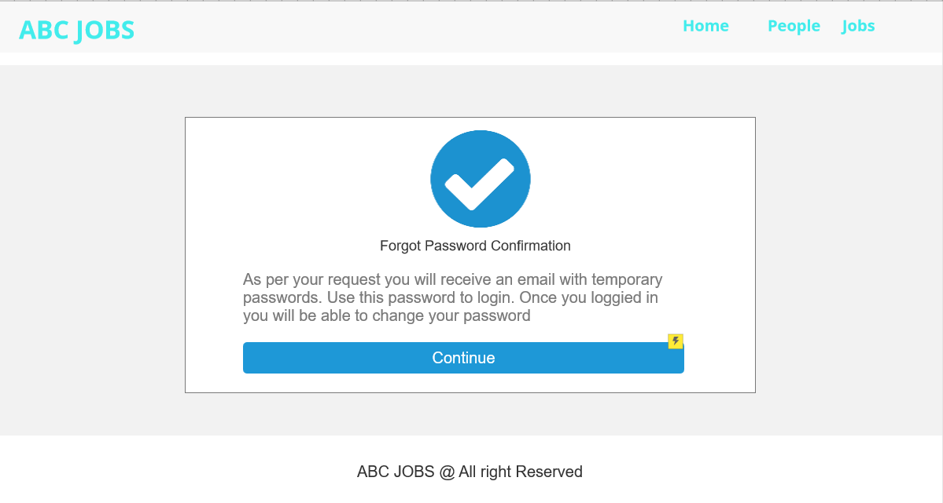
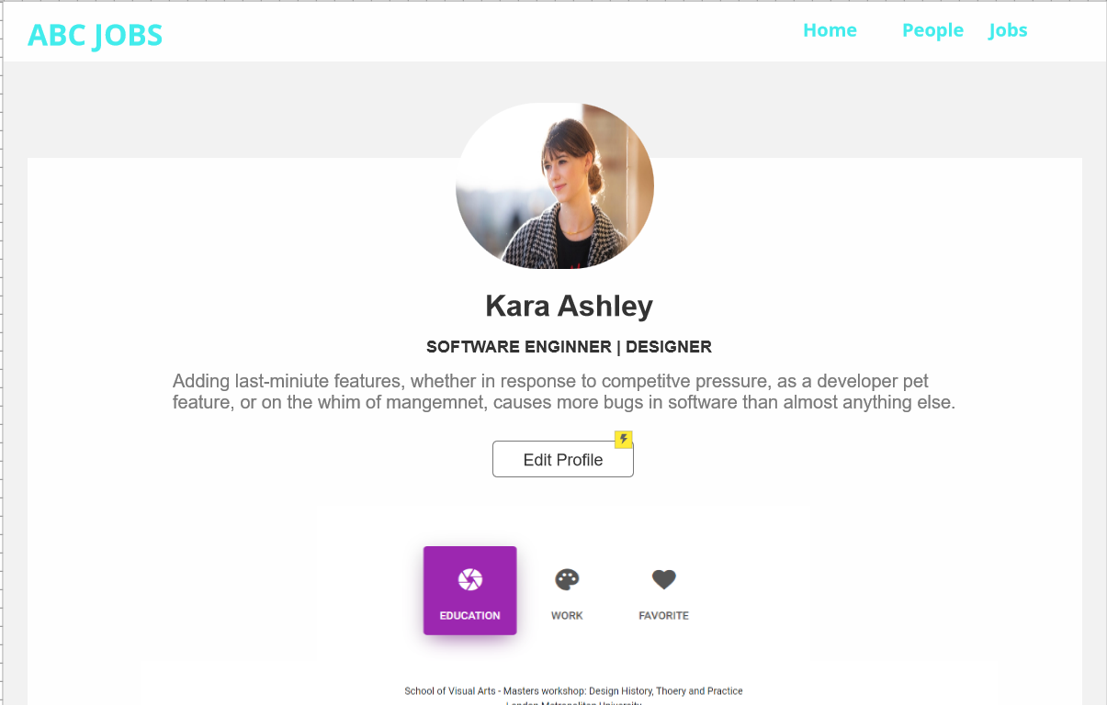
11. Prototype Screen
Forgot password Confirmation
User Profile page

Slide 32
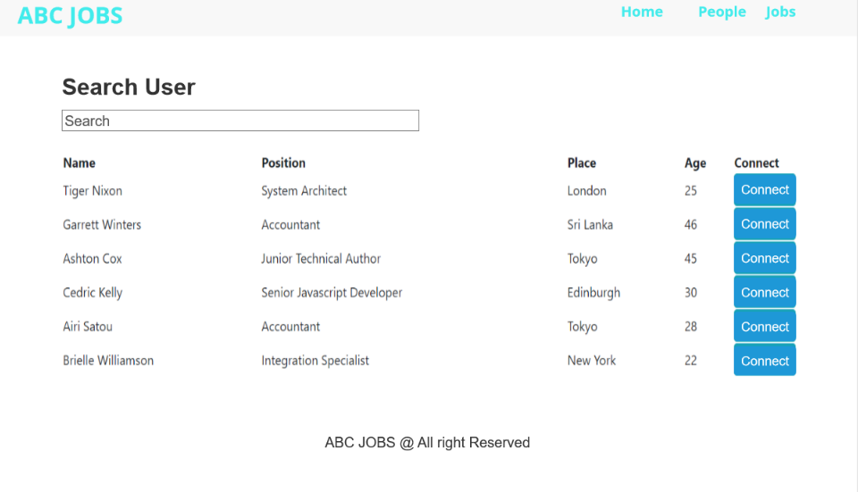
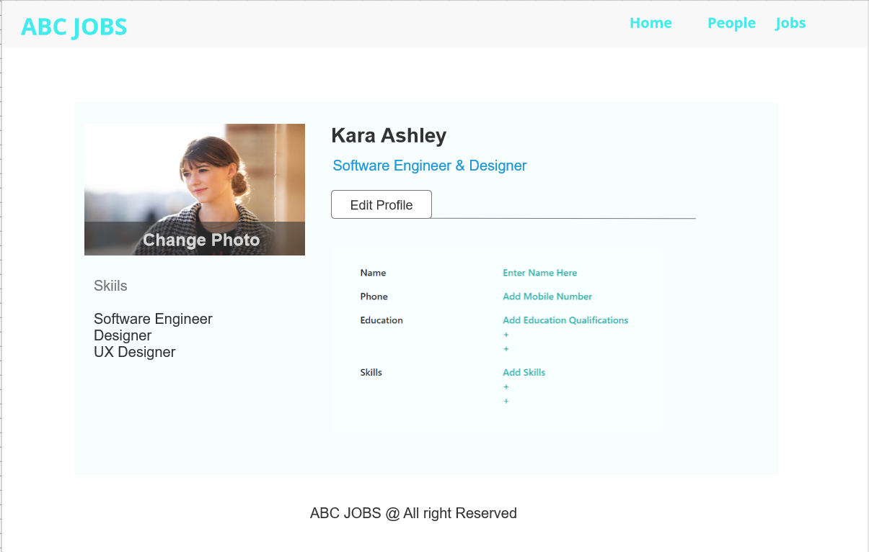
11. Prototype Screen
Search User list
Update profile page

Slide 33
12. Prototype Feedback
1. Community Portal Home Page – Add Logo
2. Registration Page – Add county dropdown
3. Registration Confirmation Page – All good
4. Update Profile Page – Add cover photo section
5. Search Users Page – Add types (like city, education, etc,)
6. List Search Results
7. Public Profile Page -
8. Registration Confirmation Email – All good
9. Login Page – Add username field without email
10. Forget Password Page – All good

Slide 34
13. Usability Test
Registration Page
Participant Name | TOT (Seconds) | UER | TSR | Observation | Feedback
Chathu | 47 | 0 | 1 | All good | No feedback
Tharuka | 53 | 2 | 1 | Not entering phone code | No feedback
Thusith | 39 | 1 | 1 | Not select gender | No feedback
Cara | 41 | 0 | 1 | All good | Add Region
Rahul | 43 | 0 | 1 | All good | No feedback
 | TOT | UER | TSR
Average Score | 30 | 30% | 100%

Slide 35
13. Usability Test
Update Profile Page
Participant Name | TOT (Seconds) | UER | TSR | Observation | Feedback
Chathu | 32 | 0 | 1 | All good | No feedback
Tharuka | 52 | 1 | 1 | Trying to change email | No feedback
Thusith | 44 | 0 | 1 | All good | No feedback
Cara | 32 | 1 | 1 | Trying to change email | No feedback
Rahul | 20 | 0 | 1 | All good | No feedback
 | TOT | UER | TSR
Average Score | 36% | 28% | 100%

Slide 36
14. Project Milestones & Tasks
Project Task ID | Project Task Description | Project Milestone ID
1 | Create requirement specification | 1
2 | Develop wireframe/prototype for the website | 1
3 | Develop user interaction steps and flowchart | 1
4 | Develop HTML Pages with Bootstrap and Angular | 2
5 | Analysis user experience | 2
6 | Test the application | 2

Slide 37
15. Milestone Feedback & Action taken
Project Milestone ID | Milestone Feedback received from Tutor / Learning Facilitator | Action Taken (Yes / No)
1 | Add icon to update photo in update profile page | yes
2 | Add validations to phone numbers | No
3

Slide 38

16. Project Results (1/2)
List of HTML Pages being Produced
Homepage
Login Page
Registration Page
Registration Confirmation Page
Registration Confirmation Email page
Forgot Password Page
Forgot Password Confirmation Page
Search Users Page
Public Profile View Page
Profile Page
Edit Profile Page
Links of the Pages
Localhost:4200/login
Localhost:4200/registration
Localhost:4200/reg-con-email
Localhost:4200/reg-con
Localhost:4200/user-search
Localhost:4200/search-list
Localhost:4200/forgot-password
Localhost:4200/forgot-pass-confirm
Localhost:4200/user-profile
Localhost:4200/edit-user-profile

Slide 39


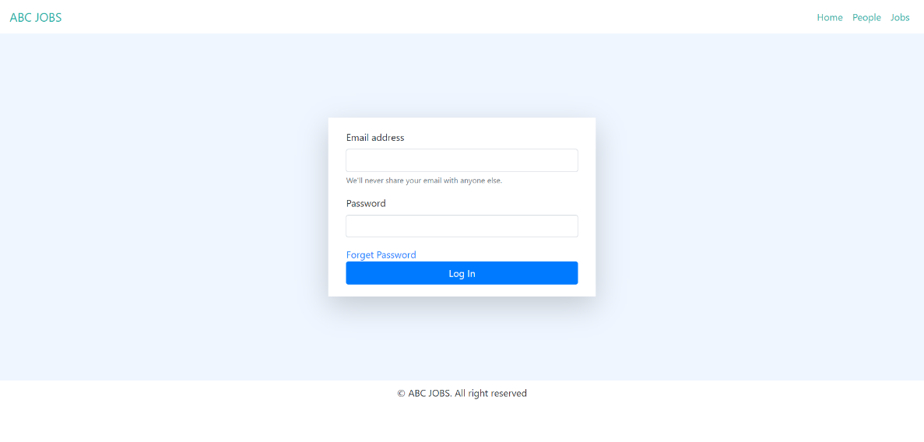
16. Project Results (2/2)
Screen Capture of Pages Using Bootstrap & Angular

Slide 40
16. Project Results (2/2)

Slide 41

17. Proposed Improvements
List of Improvements
Add Validations to all text fields
Use gradient color in all pages

